Slide 1
Vocab: Define the following in your journal. Pages 330-377
Clear-cutting
Deforestation
Biological pest control
Pollinator
Genetic engineering
Genetically modified (GM) organisms
Biotechnology

Slide 2
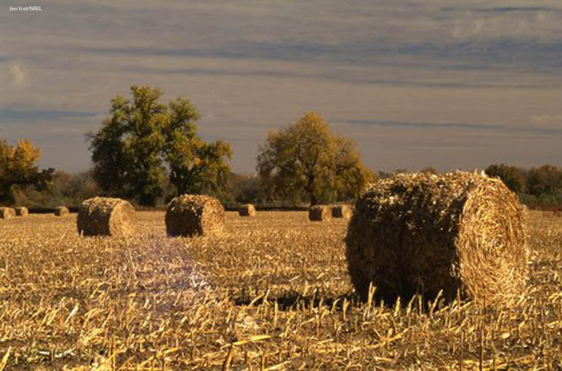
Lesson 12.3 Agriculture
Humans have been practicing agriculture for about 10,000 years.

Slide 3
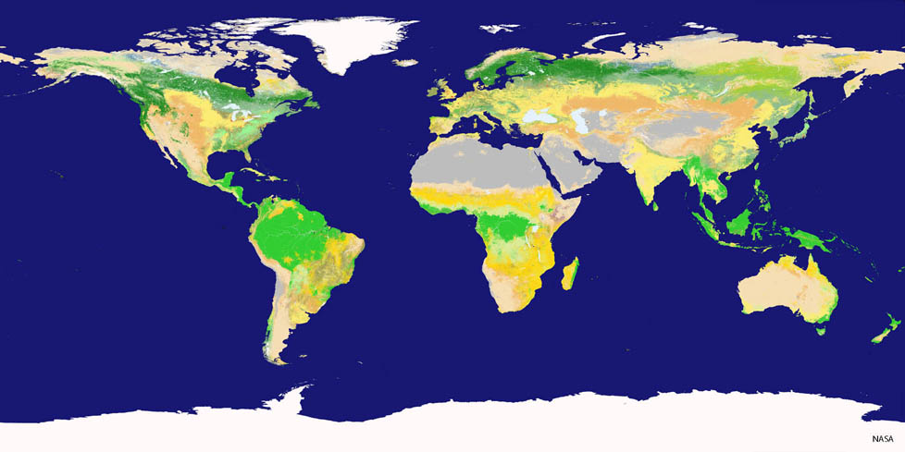
Lesson 11.2 Forests and Their Resources
Forests, mostly boreal forests and tropical rain forests, cover about 30% of Earth’s land.

Slide 4
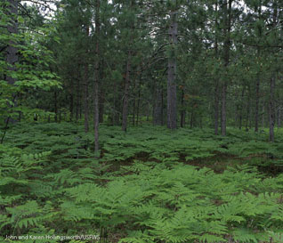
Value of Forests
Lesson 11.2 Forests and Their Resources
Ecological value:
Provide habitat for organisms
Source of biodiversity
Prevent erosion
Purify water
Store carbon, release oxygen
Economic value:
Timber for lumber and fuel
Source of food
Raw material for many medicines

Slide 5
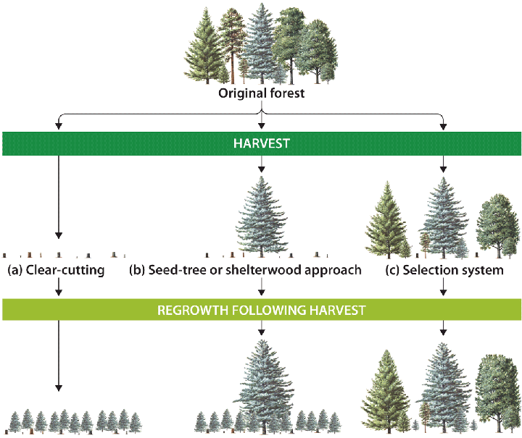
Timber Harvesting Methods
Lesson 11.2 Forests and Their Resources
Three methods: Clear-cutting, seed-tree or shelterwood approach, and selection system
May result in even-aged or uneven-aged regrowth
Even-aged regrowth tends to be less biodiverse than uneven-aged regrowth.
Did You Know? Today most commercial logging in the U.S. occurs in western coniferous forests and southern pine plantations.

Slide 6
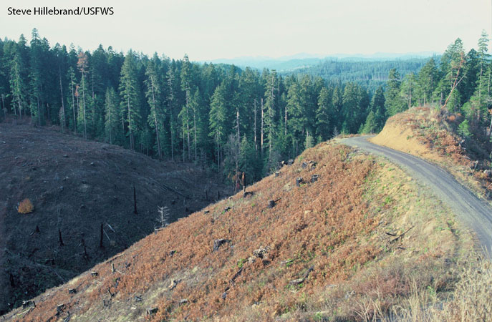
Clear-Cutting
Lesson 11.2 Forests and Their Resources
Involves cutting down all trees in a region, resulting in even-aged stands of regrowth
Changes abiotic conditions in the area, including light penetration, precipitation, wind, and temperature
Benefit: Cost efficient
Costs: Entire communities usually displaced or destroyed; causes soil erosion.

Slide 7
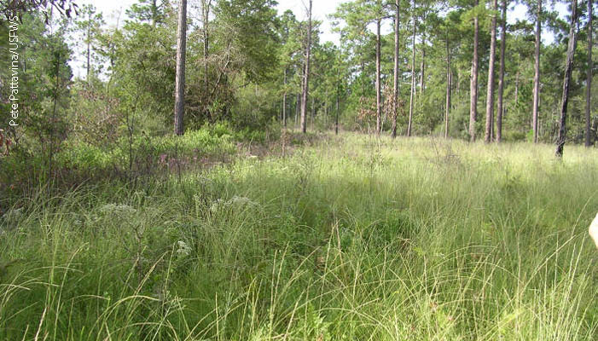
Seed-Tree and Shelterwood Approaches
Lesson 11.2 Forests and Their Resources
Seed-tree: Small numbers of mature, healthy trees are left standing, to reseed the area.
Shelterwood: Involves leaving a few mature trees standing to provide shelter for seedlings
Benefit: Less damaging than clear-cutting
Cost: As with clear-cutting, leads to mostly even-aged regrowth

Slide 8
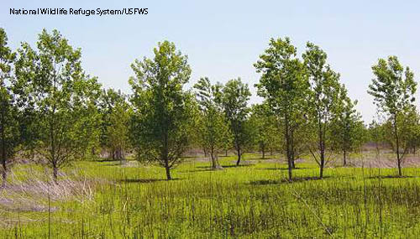
Selection Systems
Lesson 11.2 Forests and Their Resources
Relatively few trees are cut at once under a selection system.
Selection can involve widely spaced single trees or groups.
Benefits:
More biodiverse, uneven-aged growth
Less overall environmental damage
Costs:
Machinery disturbs forest interior.
Expensive process
More dangerous for loggers

Slide 9
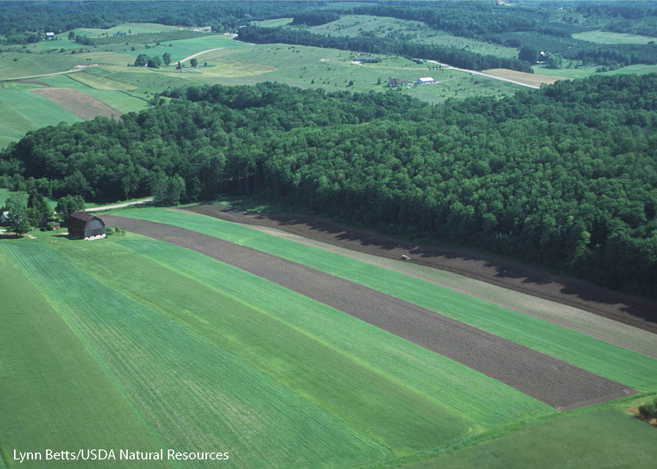
Deforestation
Lesso 11.2 Forests and Their Resourcesn
Unlike timber harvesting, deforestation replaces forested areas with some other land use, such as commercial or residential property.
Deforestation in tropical and arid regions has the most negative effects due to loss of biodiversity and desertification risk respectively.
Globally, deforestation adds CO₂ to Earth’s atmosphere.

Slide 10
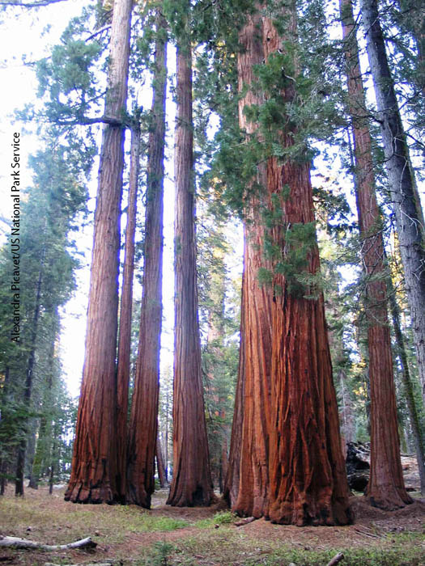
Deforestation in the United States
Lesson 11.2 Forests and Their Resources
Deforestation for timber and farmland facilitated U.S. expansion.
Wood felled for buildings and fuel during the pre- and early Industrial Revolution periods.
By the early 1900s, very little old-growth forest (forest that has never been logged) remained in the United States.
Did You Know? Once old-growth forest is logged, it may need hundreds of years to regrow.

Slide 11
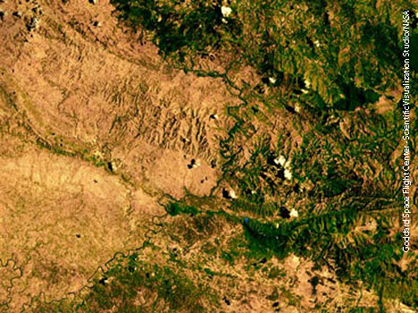
Deforestation in Developing Nations
Lesson 11.2 Forests and Their Resources
Timber from old-growth tropical rain forests is a source of income in developing nations.
Advanced technology enables deforestation to occur far faster than it has in the United States.
Deforestation of tropical rain forests has an enormously negative effect on global species diversity.
The border bewteen Haiti (left) and the Dominican Republic (right) shows Haiti’s deforestation.

Slide 12
Recycled Paper
Introduction Video
Groups of 5
Teacher will walk each group through the process
For those not currently in the lab area, you are to complete the Forest Products worksheet.

Slide 13
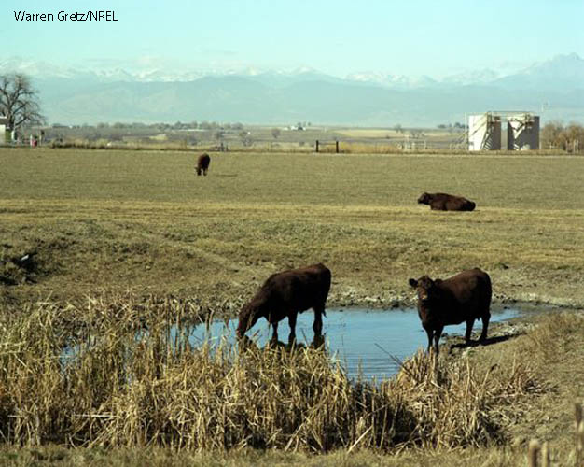
Selective Breeding and Settlement
Lesson 12.3 Agriculture
In early agriculture, people began planting seeds from plants they liked most, a form of selective breeding.
Crop cultivation enabled people to settle permanently, often near water sources, and raise livestock.
Agriculture and livestock provided a stable food supply, which allowed the development of modern civilization.

Slide 14
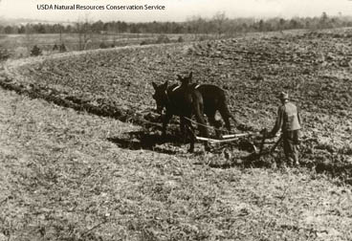
Traditional Agriculture
Lesson 12.3 Agriculture
Agriculture “powered” by people and animals
Does not require fossil fuels
Practiced widely until the Industrial Revolution

Slide 15
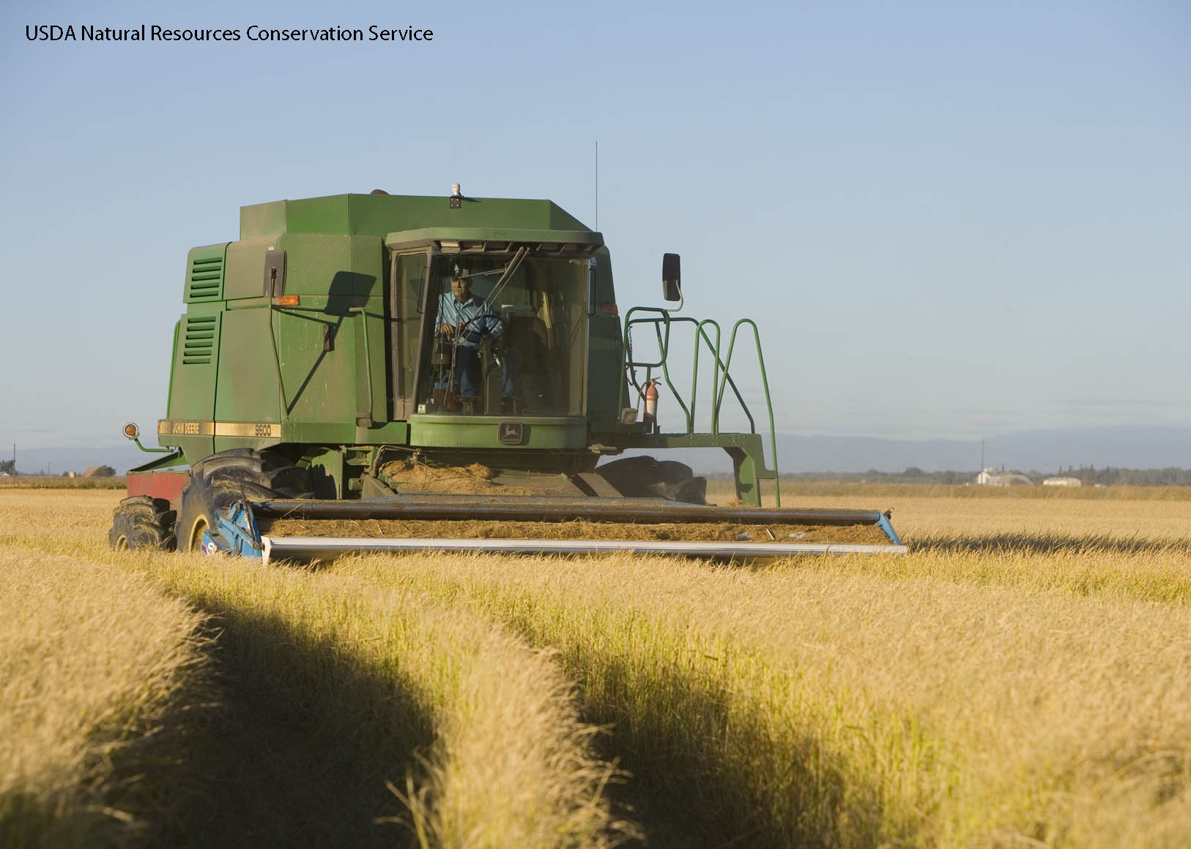
Industrial Agriculture
Lesson 12.3 Agriculture
Agriculture that requires the use of fossil fuels
Involves mechanized farming technology, manufactured chemicals, and large-scale irrigation
To be efficient, large areas are planted with a single crop in a monoculture.
Did You Know? Today, more than 25% of the world’s croplands support industrial agriculture.

Slide 16
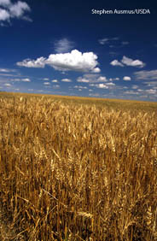
The Green Revolution
Lesson 12.3 Agriculture
Introduced new technology, crop varieties, and farming practices to the developing world in the mid- to late 1900s
Benefits:
Increased crop yields and saved millions of people from starvation in India and Pakistan
Prevented some deforestation and habitat loss by increasing yields on cultivated land
Costs:
Led to a 7000% increase in energy used by agriculture
Worsened erosion, salinization, desertification, eutrophication, and pollution

Slide 17
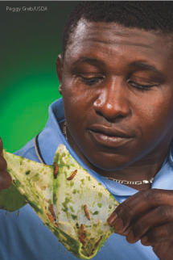
Pests and Weed Control
Lesson 12.3 Agriculture
Chemical pesticides: Effective and cheap, but can lead to resistance
Biological pest control: Permanent solution, but can harm nontarget organisms
Integrated pest management: Increasingly popular solution, combines chemical and biological pest-control methods
Cactus moth larvae are used to control prickly pear cactus, but also threaten many rare, native cacti around the world.

Slide 18
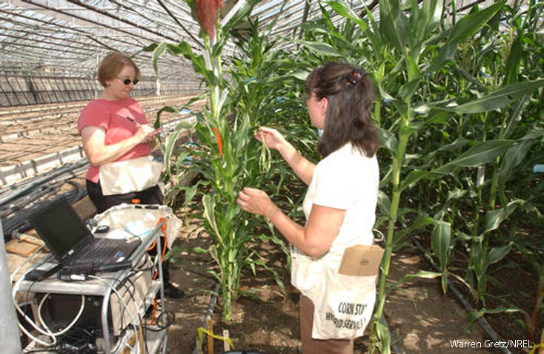
Genetically Modified Organisms
Lesson 12.4 Food Production
Organisms that have had their DNA modified
Commonly engineered traits include rapid growth, pest resistance, and frost tolerance.
In the United States, 85% of corn and 90% of soybean, cotton, and canola crops come from GM strains.

Slide 19
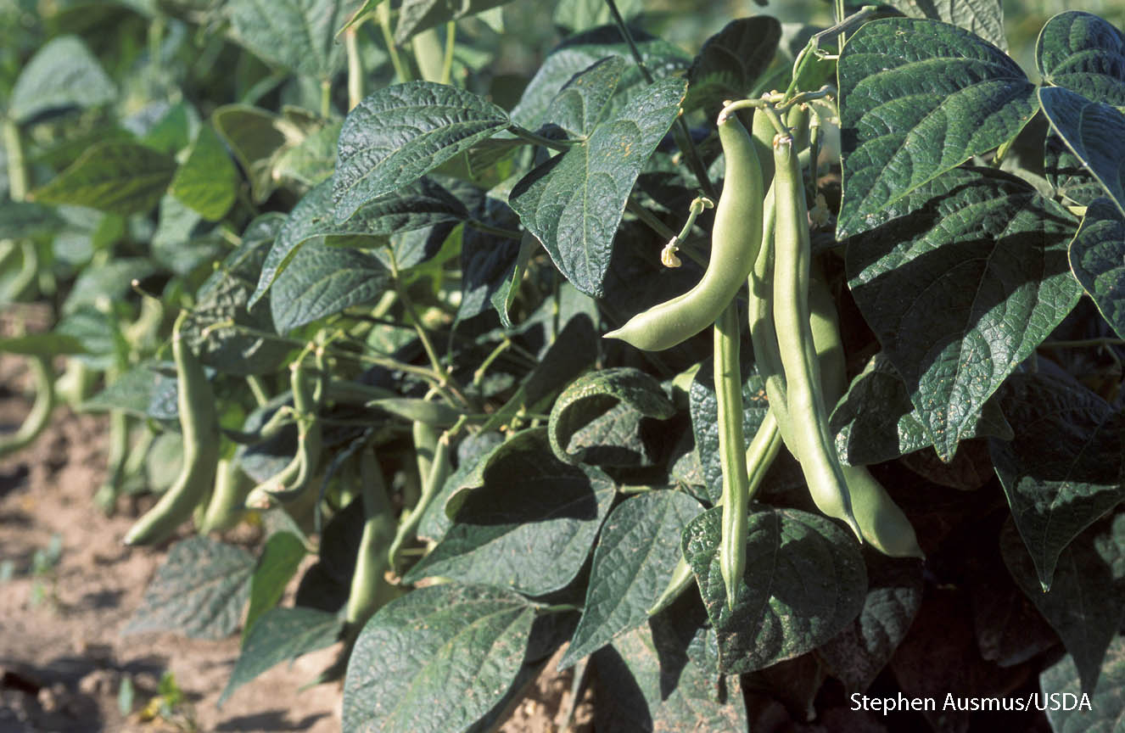
Risks and Benefits of GM Crops
Lesson 12.4 Food Production
Risks:
Potential for “superpests” that are resistant to pest-resistant crops
Contamination of non-GM plants
Benefits:
Insect-resistant crops reduce the need for insecticides.
Herbicide-resistant crops encourage tillage conservation.

Slide 20
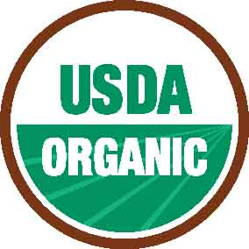
Sustainable Agriculture
Lesson 12.4 Food Production
Does not deplete soil faster than it forms
Does not reduce the amount or quality of soil, water, and genetic diversity essential to long-term crop and livestock production
Organic agriculture is sustainable agriculture that does not use synthetic chemicals.
Local, small-scale agriculture reduces the use of fossil fuels and chemicals used for transportation and storage.
Did You Know? Organic food purchases increased 200% from 1999 to 2008.

Slide 21
Today’s assignments
Page 372 (1-4)
Page 383 (1-4)
Classwork (7c vocabulary)
Biological pest control
Pollinator
genetic engineering
genetically modified (GM) organisms
biotechnology

